Slide 1
Grundtvig and Danish Folk High Schools

Slide 2
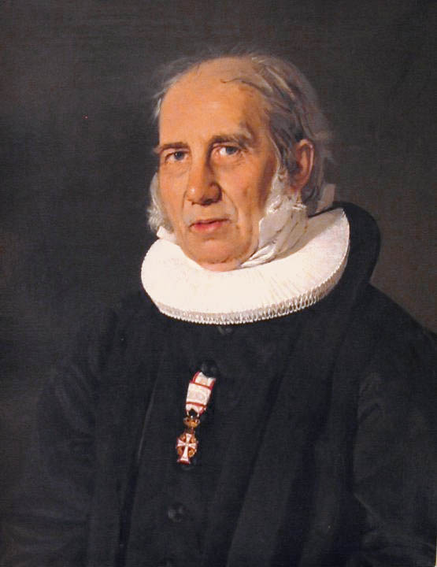
Nikolaj Frederik Severin Grundtvig, 8 September 1783 – 2 September 1872),
Danish pastor, author, poet, educator, philosopher, historian, teacher, philologist, and politician.
Influential - the ideological father of the Folk High School
Grundtvigianism
Most represented poet in The Folk High School Songbook and The Danish Hymn Book
Married 3 times
5 children

Slide 3
Danish Golden Age, First half of 19th Century
Son of Lutheran Pastor, Udby, Vordingborg
Danish National Consciousness
Very religious atmosphere
Old Norse legends and traditions
Theology in Copenhagen
Very ambitious → author
Tutor at Manor House → in love with the lady of the house → awoke his passions and writing
Enlightenment
Romanticism (Henrik Steffens – his cousin, Adam Oehlenschläger, Digte 1803)
Nordic History
Icelandic Sagas

Slide 4
Crisis, 1810
His father was aging
Grundtvig needed to be his chaplain – agreed reluctantly
Held the obligatory sermon in Copenhagen
Was reprimanded
Became mentally ill, was transported home by two friends
Recovered within a few months
Wrote ”Dejlig er den Himmel Blå”
Felt himself awakened from his hubris
Gave up ambition to become an author
Replaced Romanticism with strong Lutheranism

Slide 5
Incredibly active public life
Writing and Priesthood
History
Works of History (World History)
Not accepted as his father’s successor
Polemical
1815: no more sermons until he had his own parish
Magazine: Dannevirke 1816-19
Feuds with various authors
1821: Pastor in Præstø
1822: chaplain in Copenhagen
1826: censured
Denmark and Norway separated in 1815
Translation of Gesta Danorum (Saxo Grammaticus - Danish history)
Translation of Beowulf 1820 (taught himself Old English)
1826 – celebrating 1000 years of Christianity in Denmark – hymns
Introduction of the term: Grundtvigian – supporters and congenial spirits

Slide 6
3 trips to England – supported by King Frederik 6
1830s – New thoughts about the Danish state
Combination of monarchy and the popular voice
1837: censureship repealed
Public lectures – very popular
Friendship with the Crown Princess Caroline Amalie (Queen in 1839)
Pastor at Vartov Church 1839-72
Writings about education:
Skolen for Livet og Academiet i Soer, 1838 (School for Life and The Academy at Soer)
Bøn og Begreb om en dansk Højskole i Soer, 1840 (Prayer and comprehension of a Danish High School in Soer)

Slide 7
Grundtvig’s Hymns and Nationalism
Huge output → shaped Danish national and Christian perception
From mid 1830s
Wrote around 1500 hymns
Happy Christianity (in contrast to Pietism and Inner Mission)
Ideally, power emanates from the popular voice
A unique Danish popular spirit / character → build a Danish self-perception
Danish folk songs (son Svend continued the work)

Slide 8
The Folk High School
Worked as a teacher several times
Several written works about education
Education should not be based on books but the spoken, living word
Education should be historical – poetical
A school for life
Popular education and enlightenment
Huge educational influence
First Folk High School opens in Rødding in 1844
In 1944, a celebration with a Danish documentary – Den Danske Folkehøjskole:
https://www.youtube.com/watch?v=UGOpkbgPQYI

Slide 9
The Folk High School
A school where you live and choose your classes
You learn what you want
No exams
No prerequisites
A School for Everyone
Short stays 1-7 weeks
Longer stays 2-12 months
In-depth exploration of what you find interesting
More than 200 different topics
You meet a lot of new people
Above and beyond your classes, you will participate in lectures, trips, and life with others

Slide 10
75 Folk High Schools
General schools with a broad array of classes (from 17½)
High schools specializing in one topic
Gymnastics, Sports, and Physical Education schools
Christian or spiritual schools
Life-style schools
Schools for seniors
Schools for youngsters (from 16)
Most are general and Grundtvigian – several topics and subtopics
Some are specialized
You pay for your stay – but it is subsidized by the Danish state
Purpose: life-education, popular enlightenment, democratic education

