Slide 1
Johannes V. Jensen, 1873-1950
Kongens Fald, 1900-1901
The Fall of the King, transl. 2012
V. = Vilhelm

Slide 2
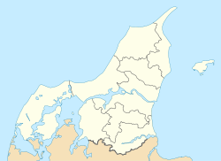
Life etc.
Born in Farsø,
Died in Copenhagen
Farsø, West Himmerland

Slide 3
Map of the different areas in Denmark
”Nordenfjords”

Slide 4
Life cont.
10 siblings, second oldest
Father interested in science,
Atheists
Sister Thit Jensen, writer, feminist; conflict
Painted as a young man
Gymnasiet in Viborg, graduated 1893
Studied medicine, Copenhagen University, 3 years,
Dropped out, focused on writing (12 novels already)
Married Else Marie Ulrik, 3 sons
Wrote: poems, articles, novels, short stories
Most famous: Himmerlandshistorier, Kongens Fald, Den Lange Rejse
1902

Slide 5
1944 – Nobel Prize in Literature
”Hvor smiler fager den danske kyst”
”Ved Frokosten”
”Paa Memphis Station”
Crime stories, to make money
Translator; Icelandic Sagas, Kipling, Whitman, Shakespeare
In the US 1903
Feature articles in newspapers
Portrait busts, private

Slide 6
The Danish Cultural Canon

Slide 7
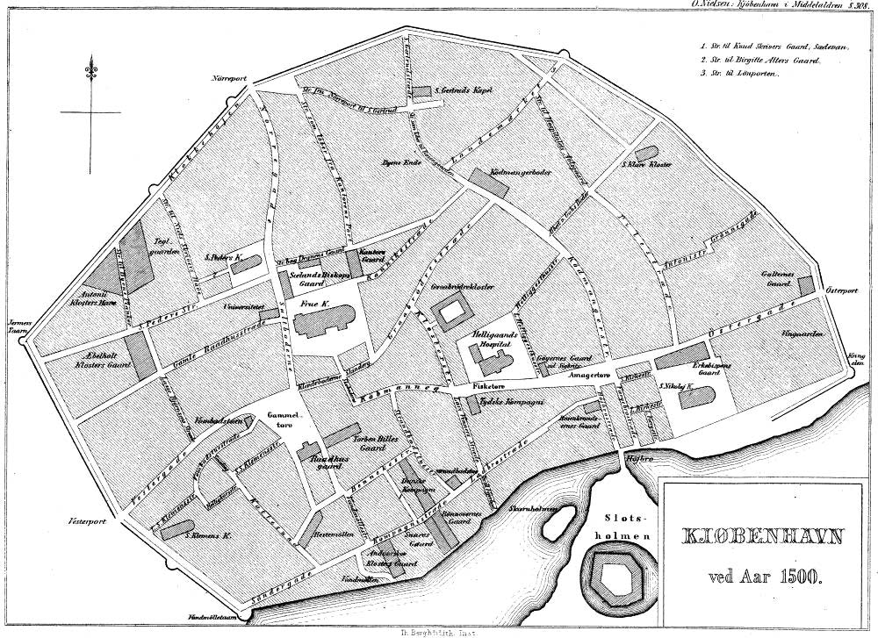
Kongens Fald
Copenhagen 1497: fortifications, until 1850s
Vesterport, Nørreport, Østerport, Højbro
Night Watchmen,
German soldiers (part of Denmark)
Dirty, enclosed, stinking
Modernist novel
Semi-historical
Mikkel Thøgersen – parallel with Christian 2.
Prince Christiern → King of Denmark and Norway 1513-1523, and of Sweden 1520-1520. Son of King Hans (John). Oldenborg lineage.

Slide 9
Kalmar Union
1397-1523: Denmark (including Schleswig-Holstein), Sweden, (including most of present day Finland) and Norway (plus Iceland, Greenland, The Faroe Islands, Orkney, and Shetland
Queen Margaret 1 of Denmark, 1353-1412
Failed because of strife between monarch and nobility

Slide 10
Life at the time
Places for and methods of Executions:
The places had to be visible from far away
Stejlebakken → breaking someone on the wheel, raising the wheel onto a standing pole
Galgebakken: Gallows hill
The executioner was paid by the officials, King, City council etc
Rakker / Natmand : Executioner’s assistant, scavenger, knacker
They cleaned chimneys, killed vagrant dogs, dragged carcasses and carrion out of the town – until 1850
Gabestok: pillory stocks
Kagstrygning: public whipping
Students:
had to beg and sing for their food until they graduated and got a job
had to participate in religious services (Denmark was catholic until the Reformation in 1536)
could not have a beard
Jews were officially welcomed in Denmark in 1634
Pentecost / Whitsun: the 7th Sunday after Easter, the Holy Spirit came to earth; national holiday today

Slide 11
Wars
Danish-Swedish War (1468–1469)
Danish – Swedish War (1470-1471)
Dethroning War against King Hans (1501-1503) (Swedes)
War against Ditmarsken, 1500
(Ditmarsken lies between the rivers Elbe and Eider)

Slide 12
Next: The Grand Summer, around 1520
Bloodbath in Stockholm November 8, 1520
80 persons executed that day
Direct reason for Christian II to lose Sweden and afterwards Denmark/Norway
Fall of the King,
January 20, 1523 the Nobles rebel
Vacillation
April 13 1523, he sailed to the Netherlands.
Returned to Denmark, Sønderborg Castle, a prisoner, 1532
Frederik I became King
Christian II: Prisoner till his death
Bishop Jens Andersen Beldenak, Bishop of Funen 1501-29
Skueret→ Show dish – the girl!
The Battle of Bogesund, 1520, Christian II wanted to gain absolute power over Sweden.
The Battle of Tiveden: same campaign
Coronation: November 4, 1520, Stockholm

Slide 13
Winter: Grevens Fejde The Count’s Feud
On the other side:
Danish nobility and Clergy
They wanted Christian (3) son of Frederik I as king
Civil war ended with a victory to Christian III and the nobility
Johan Rantzau: supported Christian III. An attempt at conquering Funen in 1534 ended in a defeat and a humiliating retreat, but in the same year Rantzau crushed Skipper Clement’s peasant rebellion in Jutland. Battle of Aalborg. The next year, he successfully conquered Funen; (Battle of Øksnebjerg) and finally led the siege of Copenhagen that ended with the triumph of Christian III.
Klemen Andersen, “Skipper Clement” 1484-1536, merchant, captain, privateer, leader of the peasant rebellion. Executed after the war ended.
Civil War, 1534-36
The Hanseatic League wanted more power
Lübeck tried to reinstate Christian II, with Count Christopher of Oldenburg as the leader of the troops
Led to rebellion among peasants and bourgeoisie, supporting Christian II

Slide 14
Gustav Trolle Feudal System 1488-1535
1282 the nobility had the king sign a document increasing their feudal power (Håndfæstning)
The nobility had to provide soldiers in the King’s wars
Peasant farmers managed the land, freeholds or copyholds
In 1500 about 12,000 peasants owned farms, about 18,000 were copyholding peasants on crown lands, and about 30,000 were copyhold tenants of lands belonging to the church or the nobles.
Lack of freedom of movement, no right to marry, change occupation, dispose of property
Bound to designated land
Providing their own food and clothing, paying a substantial portion of the grain to the lord
Archbishop of Uppsala
Chrowned Christian II on Nov. 4, 1520
Gave the King a list of people who had harmed him! – Bloodbath!
Forced to leave Sweden 1524, moved to Denmark, then the Netherlands, with the King
Mortally wounded in the battle at Øksnebjerg, 1535

